Slide 1
Simulating the FIFO, LRU, & Optimal Algorithm
Jeffrey Cuadros

Slide 2
Why have I picked that topic?
I rather code than actually write.
Optimal Page replacement looked challenging to code (and it was)

Slide 3
What have I learned?
Simulating a page replacement algorithm is HARD, specially optimal.
FIFO:
Implemented by using a Queue, which by definition is FIFO.
LRU:
Implemented by using two ArrayLists, one to keep track of all the current values, and the other to keep track of all the inserted elements.
Optimal:
Implemented by using three ArrayLists, one to keep track of all the current values inside the frame, the other one to keep track of all the inserted values, and the last one keeps track of the next values.

Slide 4
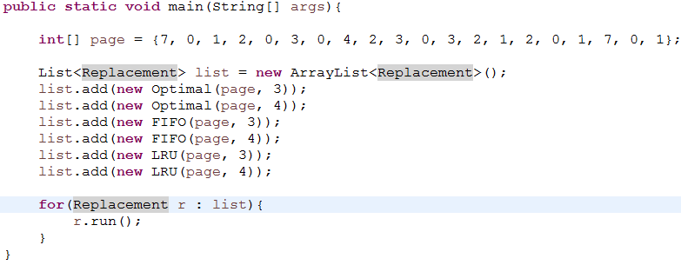
Main function:
All the algorithm implement the interface “Replacement,” that’s why I can inserted them inside the List and call the function run() as one class.

Slide 5
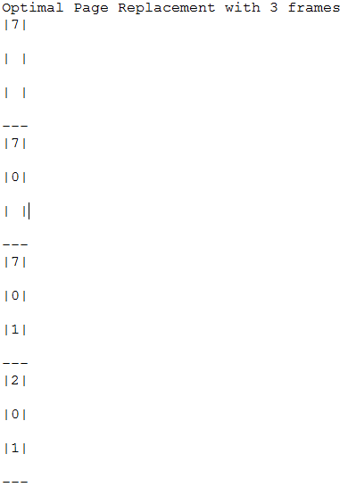
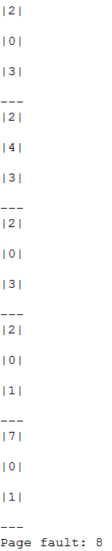
Output

Slide 6
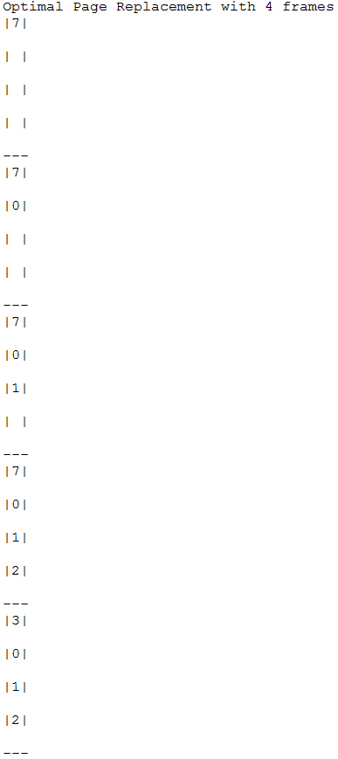
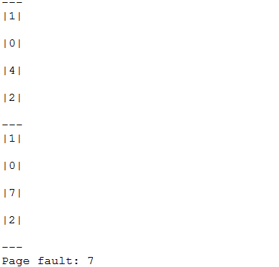
Output

Slide 7
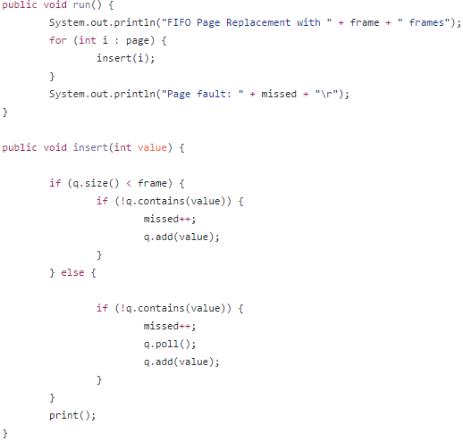
FIFO Algorithm:
“Page” is an array of ints
For each int inside the array “page” I call the function insert().
Inside the function insert() I fill the Queue “q” till its size reaches the frame. Ones q’s size reaches the frame, I check if the value is already inside “q” if is not, then I remove the value in front and add the new value at the end.

Slide 8
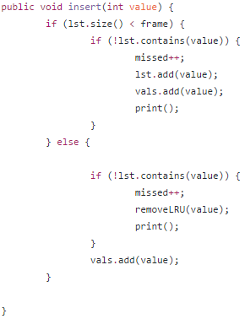
LRU Algorithm:
Same as FIFO, fill the ArrayList “lst” till its size reaches the frame size with no repeat pages.
If lst’s size is the same as the frame, then I check if the “value” is in “lst.” If is not, I call the function “removeLRU()” which will the replace the “LRU” element with the “value”.

Slide 9
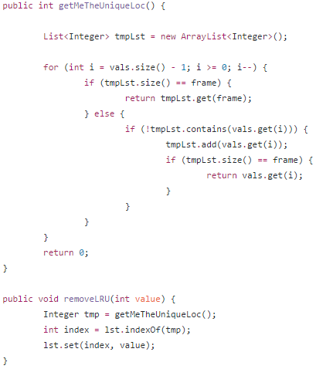
LRU Algorithm cont.
removeLRU():
Is mostly an helper function, that calls “getMeTheUniqueLoc()” that does the heavy lifting.
Once “getMeTheUniqueLoc()” returns the value, I get the index of the value inside “lst” and replace it with that “new” value.
getMeTheUniqueLoc()
Finds the value that has not been used recently, by walking backwards the ArrayList “vals”

Slide 10
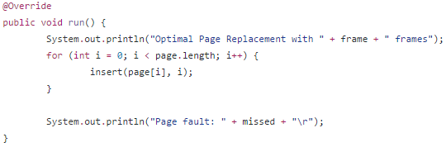
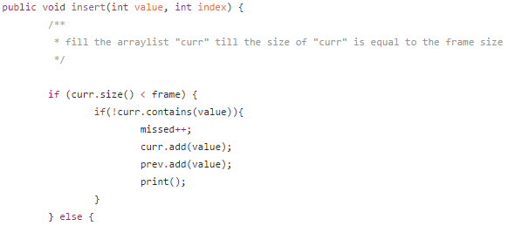
Optimal Algorithm:
Same as the other algorithms, I loop the entire array “page” and call the function insert() with two parameters the value and the index of “page”
The function insert() add non repeat values at the start of the “curr”ArrayList till the size of it equals to the frame size.

Slide 11
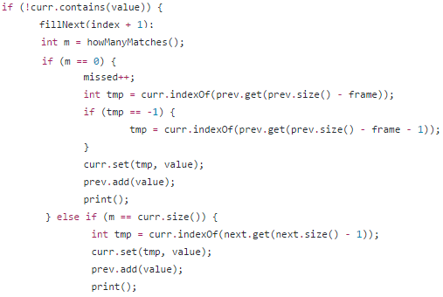
Optimal Algorithm:
If the current value is not in the “curr” ArrayList, the function fillNext() gets call to fill the “next” ArrayList. The function howManyMatches() gets call after and the return value gets saved in the interger “m”
If “m” is 0, then there were no matches, in that case, insert the value to the first inserted position.
if “m” is the same as the size of the “curr” arraylist, then they are all matches, then I take the last inserted value inside the “next” arraylist and find the position of that value inside the “curr” arraylist and replace that value at the position of “curr” arraylist with the new value

Slide 12
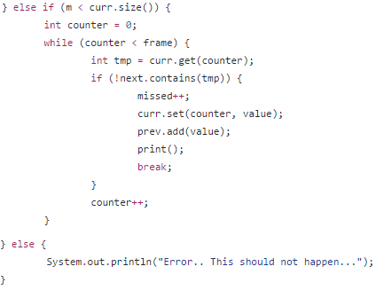
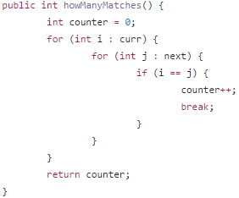
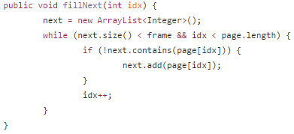
Optimal Algorithm:
If “m” is less then the size of the arraylist “curr” then I check which values are in the arraylist “curr” and “next”, If the value is not in both, then I take that position and replace the value inside there with the new value.

Slide 13
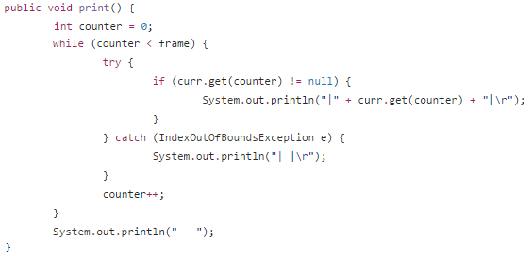
Any difficulties?
Implementing the print() functions became I bit annoying, because if the ArrayList size was less than the frame size, then it will only print the elements inside the ArrayList and there will be missing the “empty” spaces.
I resolved this issue by implementing a counter variable that enforces that the print function to print as much spots as the frame size

Slide 14
Resources:
Class notes and slides
The code is uploaded on Github, if anyone wants to download it:
https://github.com/cuadrosjb/CSC440-Final-Project

